Slide 1
Flight Price PredictionProject

Slide 2
Problem Statement
The flight prices vary unexpectedly over time. The price so higher if we must travel within a week and it is less if the tickets are booked well in advance. So in this project we have to create a model to predict flight prices and analyse how prices vary with the time of booking. So here we are working on this project in 2 phases:
Data Collection: I collected used flight data from yatra.com
Analysing the data and building the model.

Slide 3
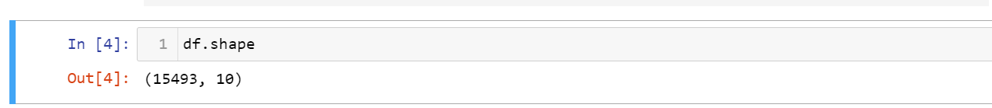
Exploratory Data Analysis
Shape of the data:
Null values present:
The dataset has no null values.
Data set is collected from yatra.com from various cities as Delhi, Chennai, Bhopal, Mumbai, Bangalore etc.
Below is the shape of data:

Slide 4
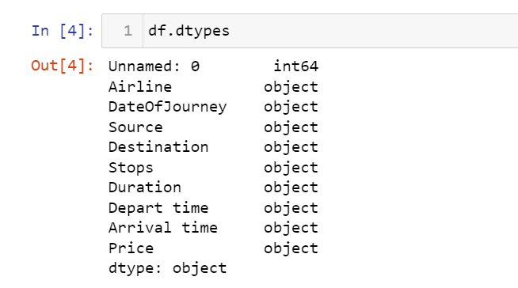
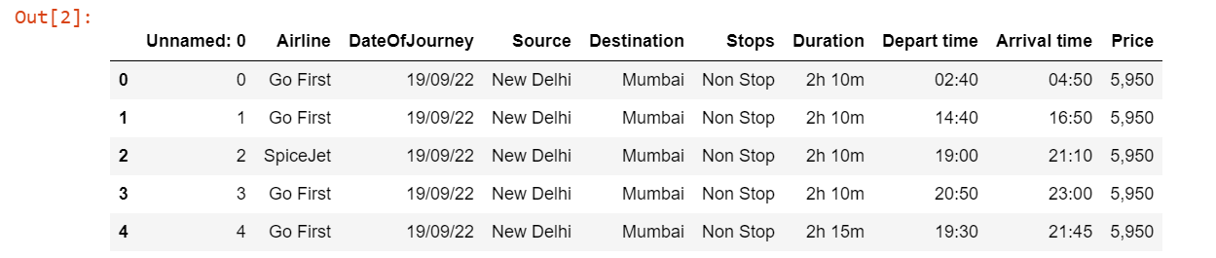
Following are the columns present and their respective data types:
Here is the glimpse of data:

Slide 5
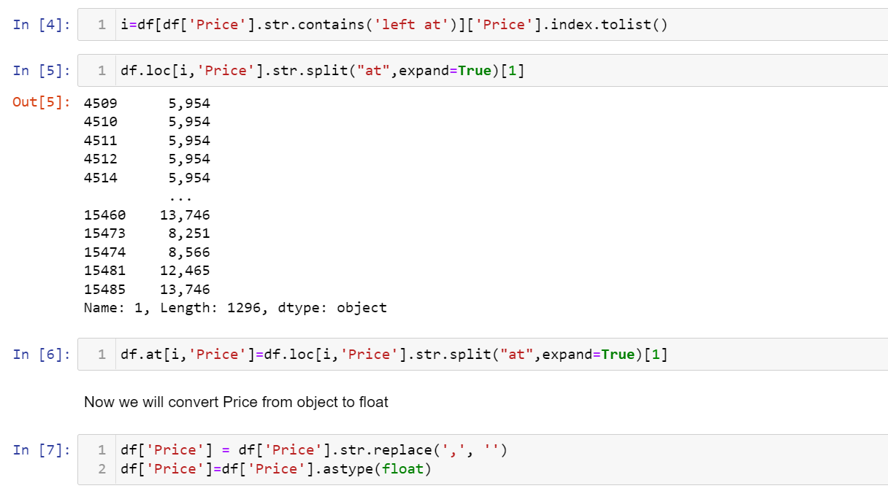
The dataset had no null values but the label price was as object data type as in some rows there were
string along with price so I just cleaned those rows by removing the string and separating price from it. Further I converted
Price label into float type.

Slide 6
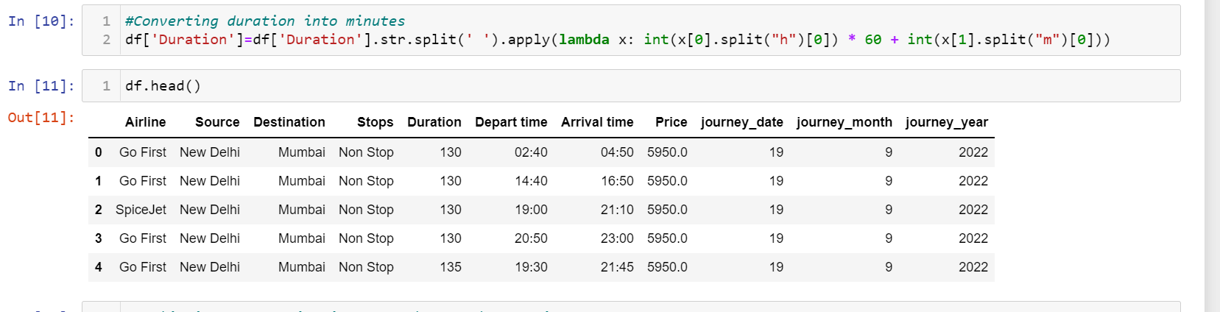
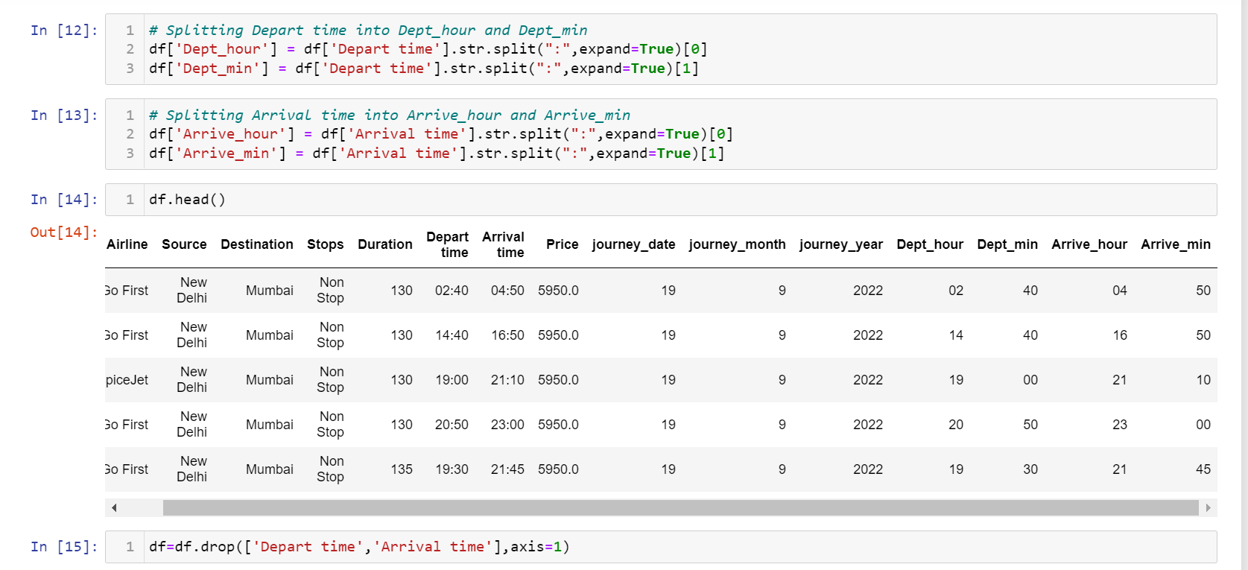
Duration was in hours and minutes format so I performed feature engineering and converted it into minutes.
Departure time and arrival time were in hours nad minutes format so I split both times into hours and minutes and created
4 new columns Dept_hour, Dept_min, Arrive_hour and Arrive_min and further deleted the depart_time and Arrival_time
column.

Slide 7
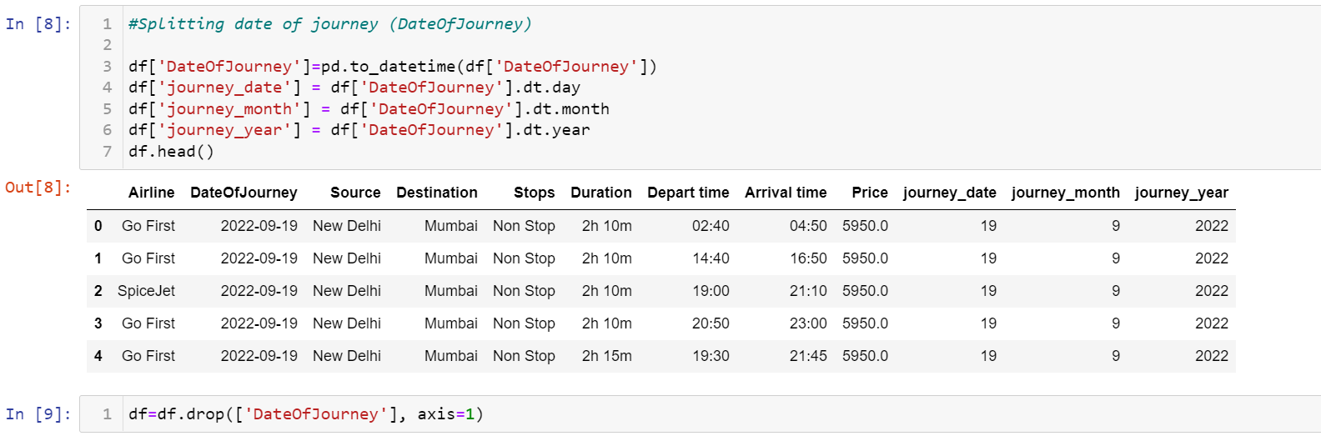
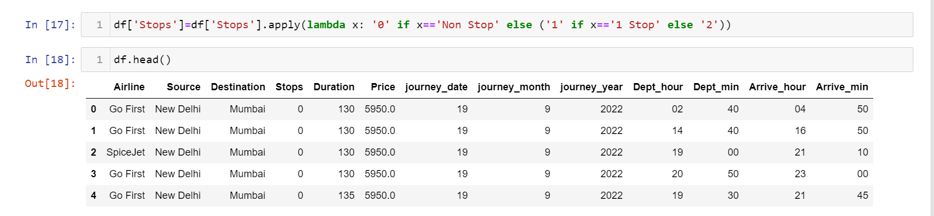
I also performed feature engineering on dateOfJourney by splitting it into journey_date, journey_month and journey_year.
Further I converted stops into numerical value 0,1 and 2.

Slide 8
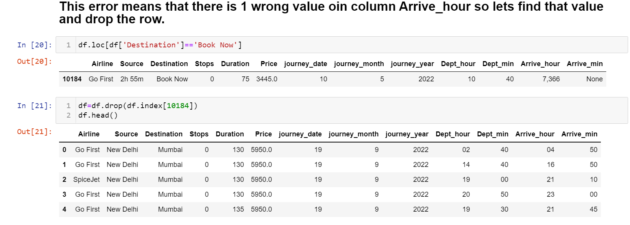
I found out that there was one row with wrong data so found that row index and further drop it.

Slide 9
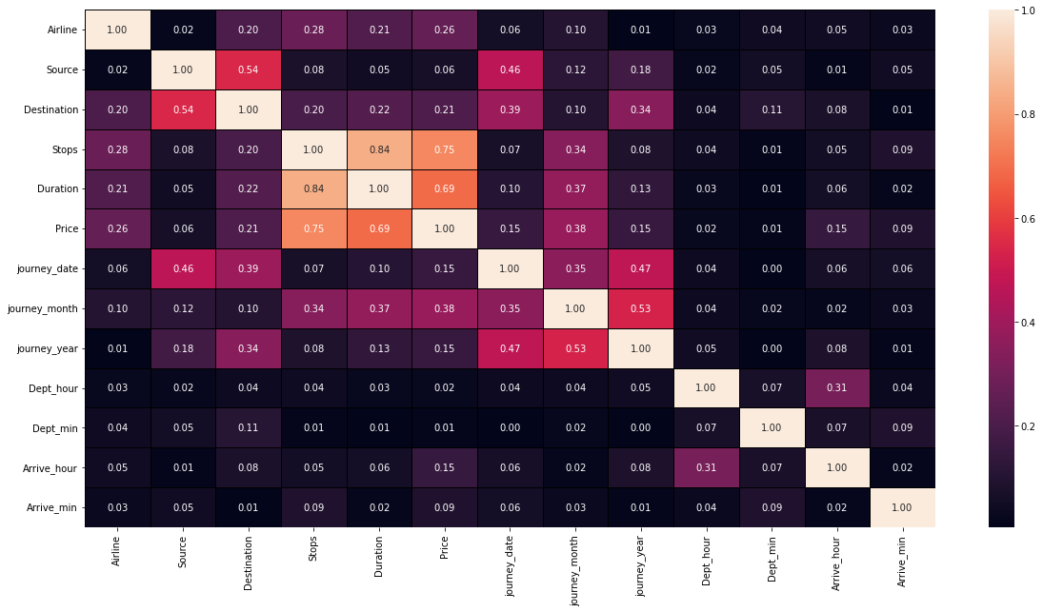
I tried to find out relation between features and label using heat map and found out that multicollinearity
could exists between few features.

Slide 10
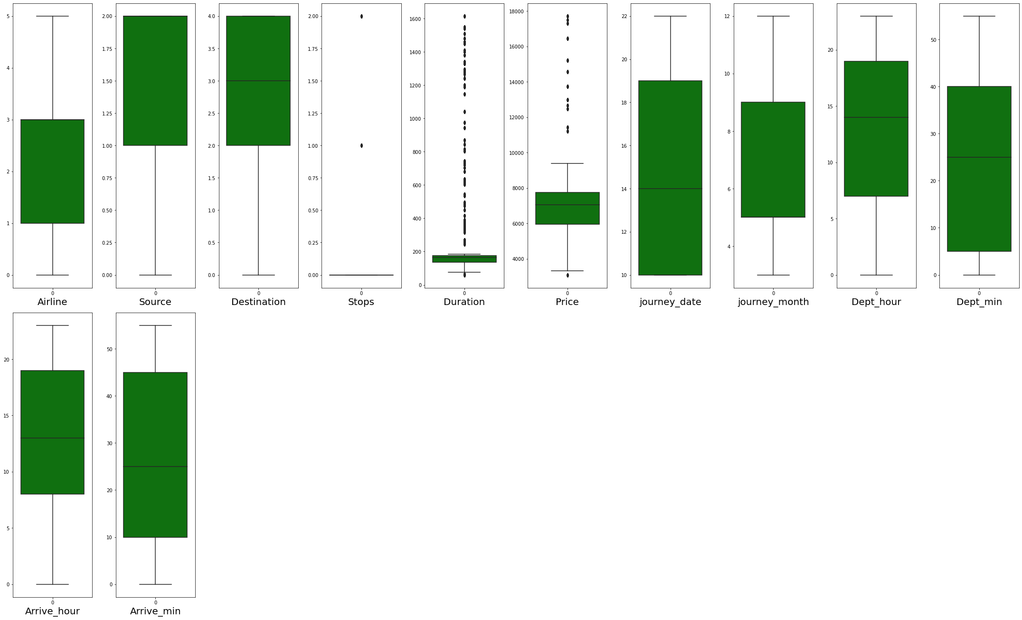
Outliers are present in Duration and Price but since Price is a label so we would consider outlier in only duration.
Since I collected the data by myself and sure of its correctness so we will proceed with this data as its not wrong values but
exceptional values.

Slide 11
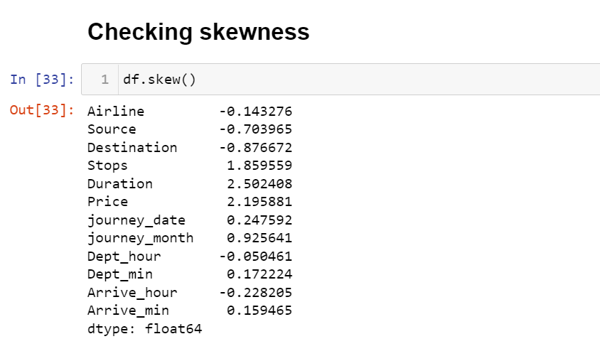
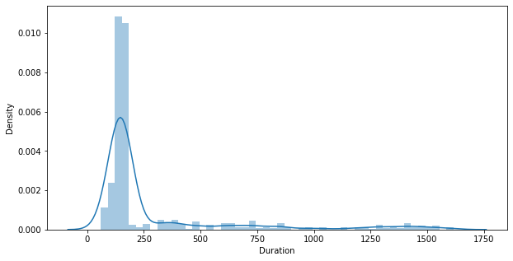
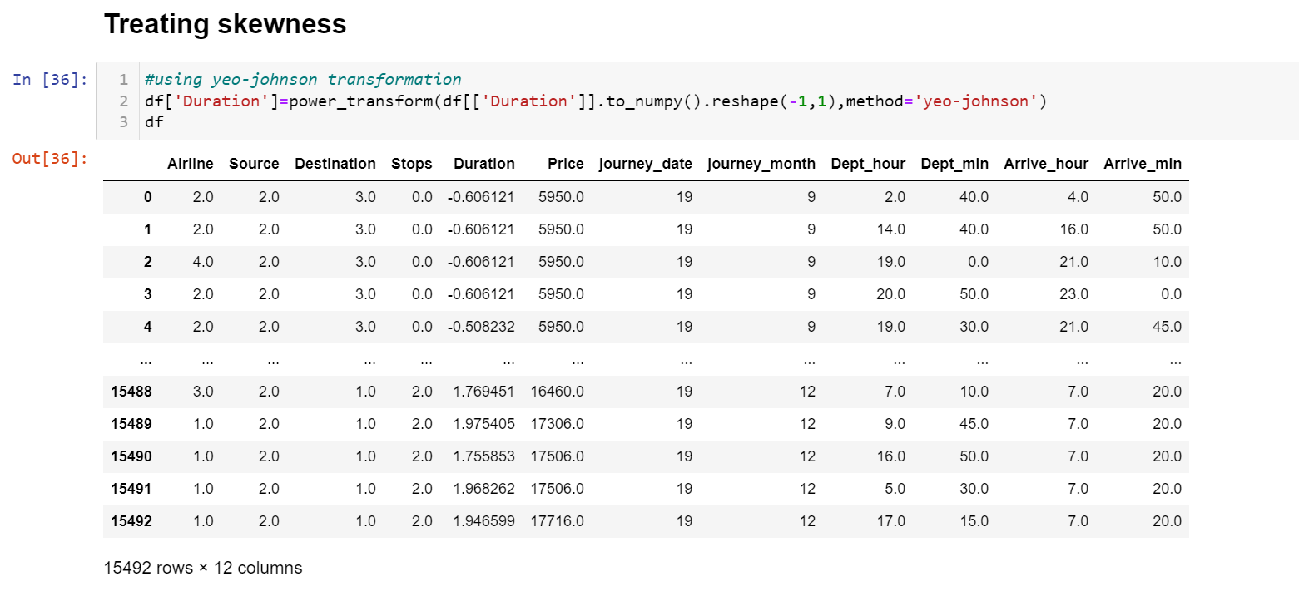
We could observe skewness in Duration. Considering the range of skewness as -0.5 to 0.5, we could observe
that Duration skewness value is 2.5 which is not in range (-0.5, 0.5) so we treated it using power transform method.
We fixed this by using yeo-Johnson transformation technique.

Slide 12
We fixed this by using yeo-Johnson transformation technique.

Slide 13
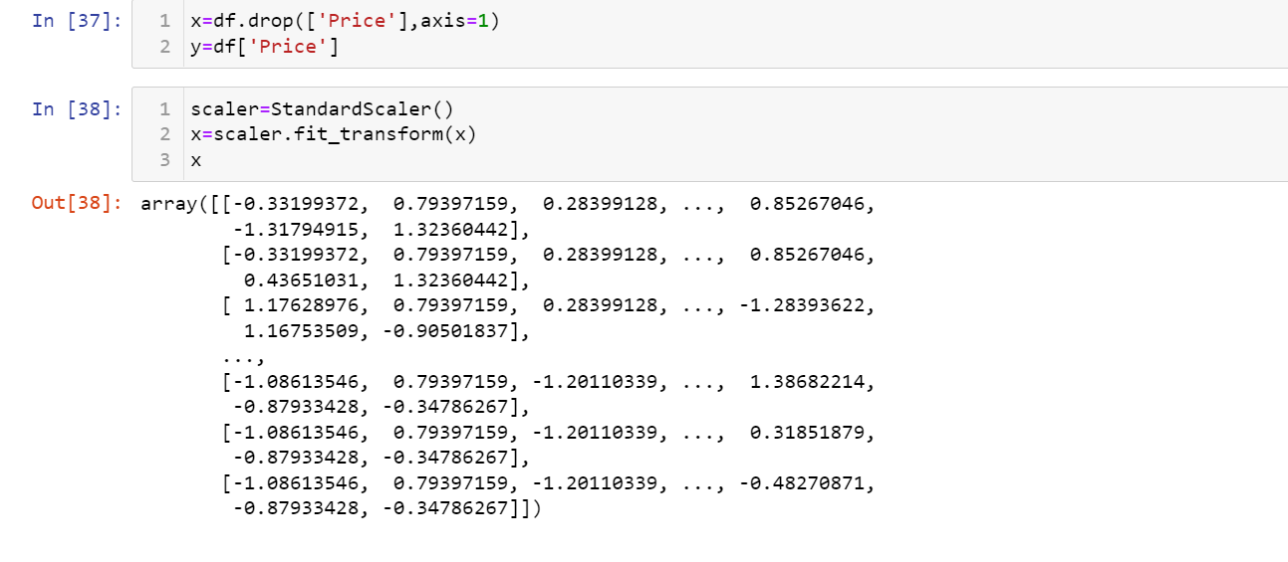
Data was then normally distributed using standardisation technique.

Slide 14
Analysing relationship between features

Slide 15
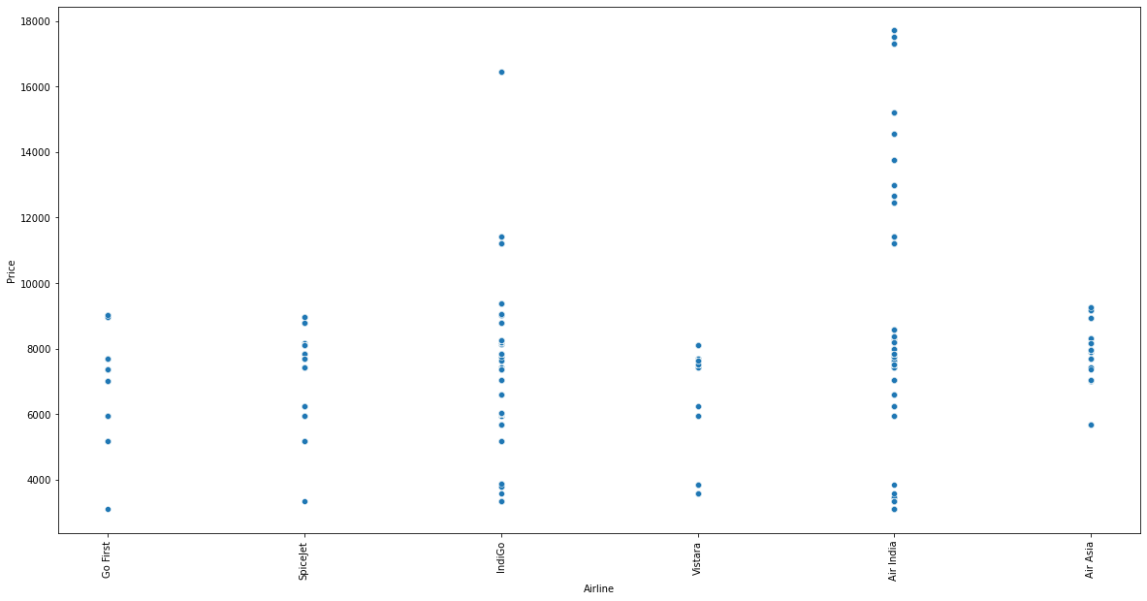
Here we can see that how price varies with the airline brand. Air India and Indigo are the most opted flights with
Air India having the highest fares.

Slide 16
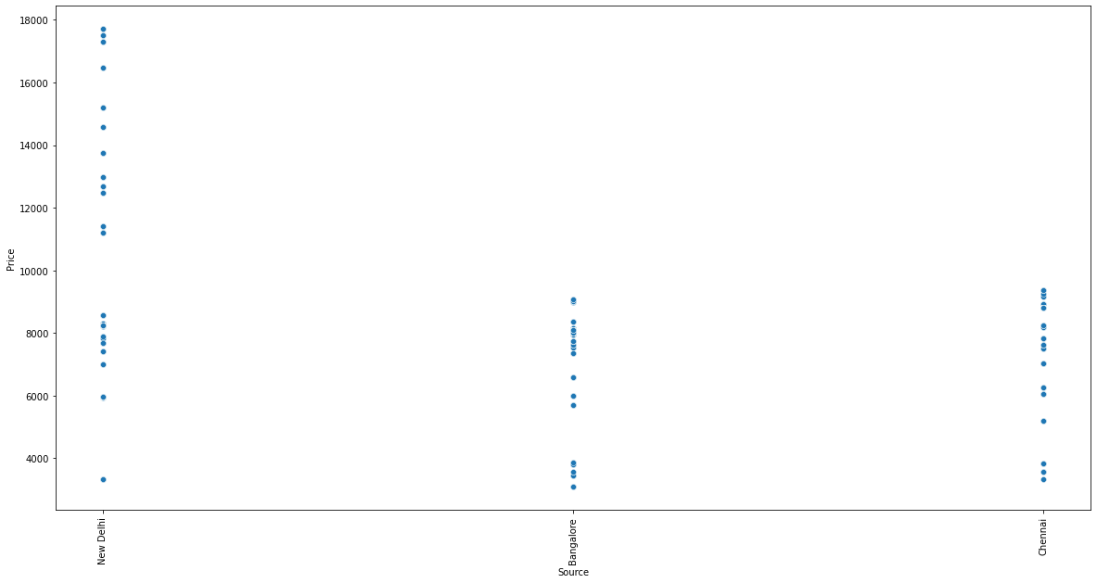
We can observe that it is costlier to travel from New Delhi as compared to Banglore and Chennai.

Slide 17
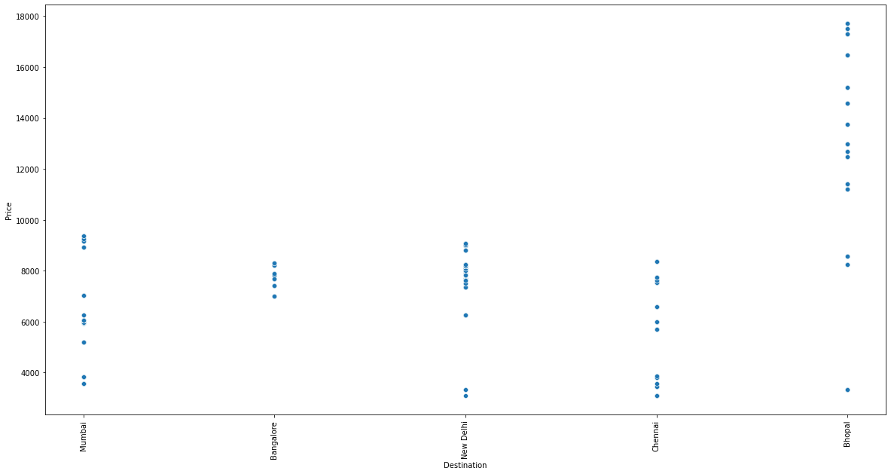
We can observe that travelling to Bhopal is costlier as compared to other cities.

Slide 18
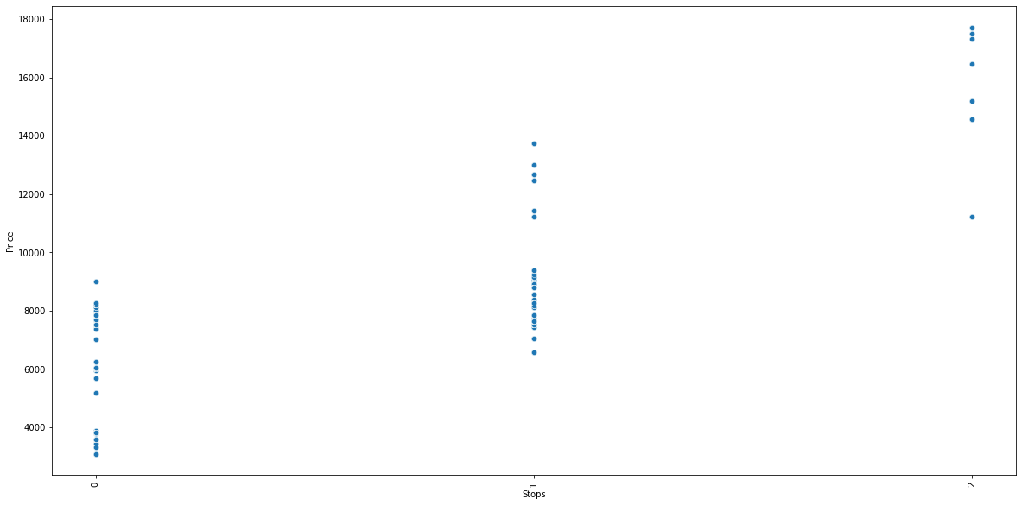
Flight with 2 stops has higher fares as compared to flights with 0 stops.

Slide 19
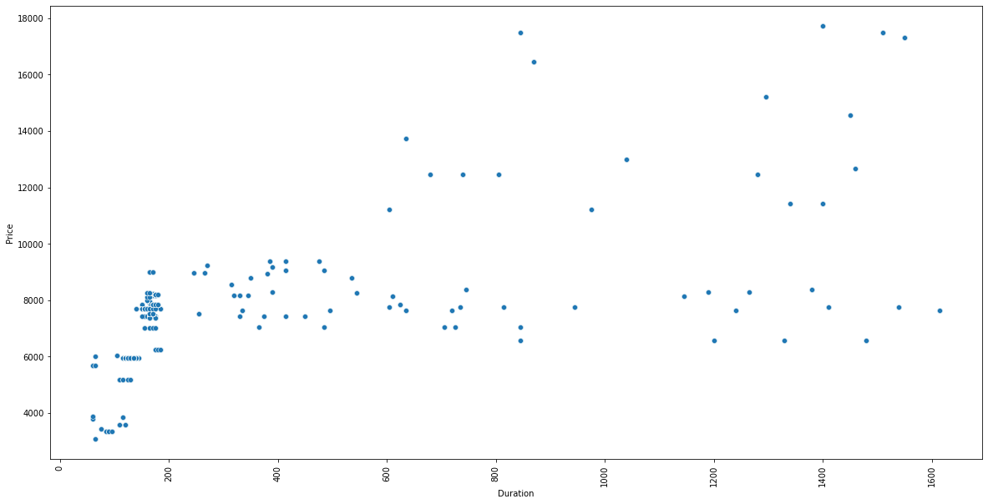
It seems that the duration is linearly related with price so more the duration more is the flight price
and vice-versa.

Slide 20
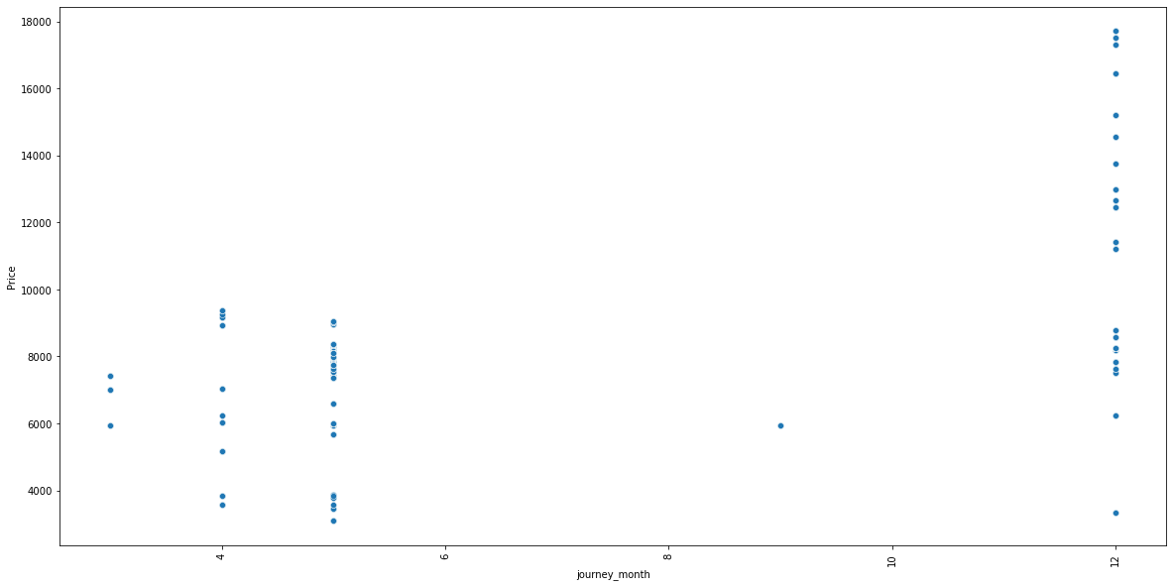
Flight prices are higher in the month of december as it is year end so lot many people prefer travelling
and enjoying the new year eve thus companies make higher profit this time of the year by following demand
supply concept.

Slide 21
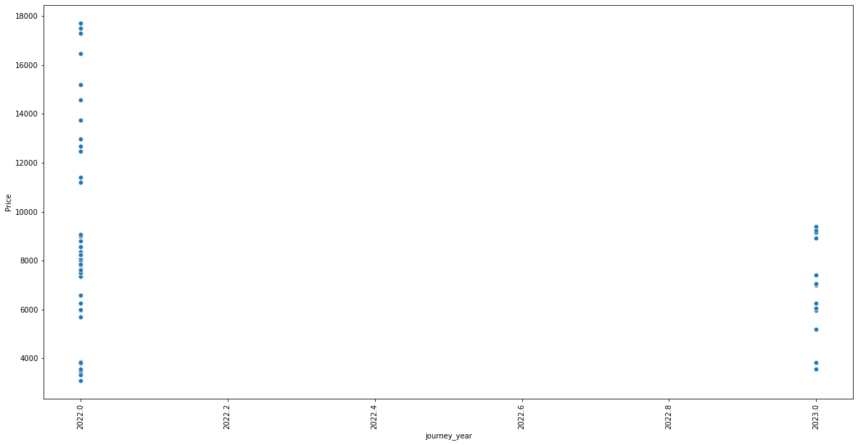
We could observe that the prices of all the tickets booked next year are way more cheaper than those
booked in the remaining months of this year.

Slide 22
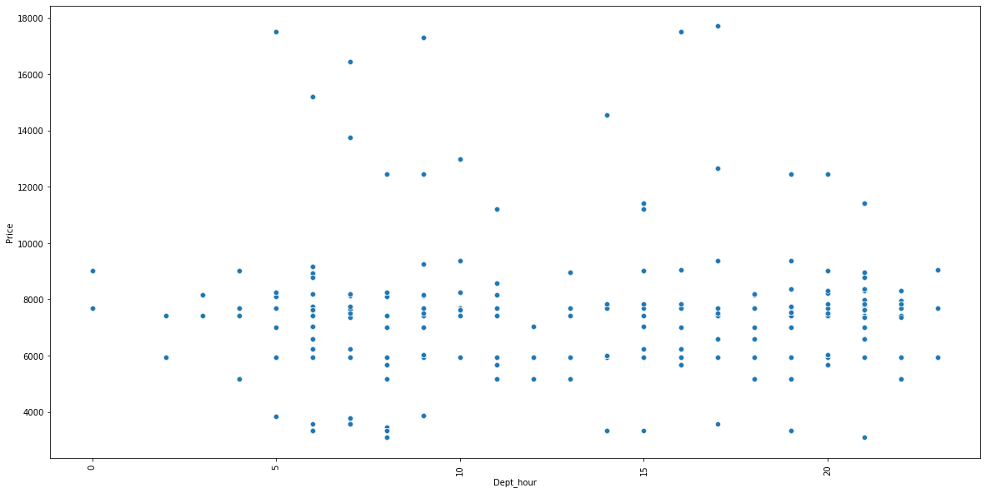
Late night flights and early morning flights are cheaper as people less prefer taking flights at these odd timings.

Slide 23
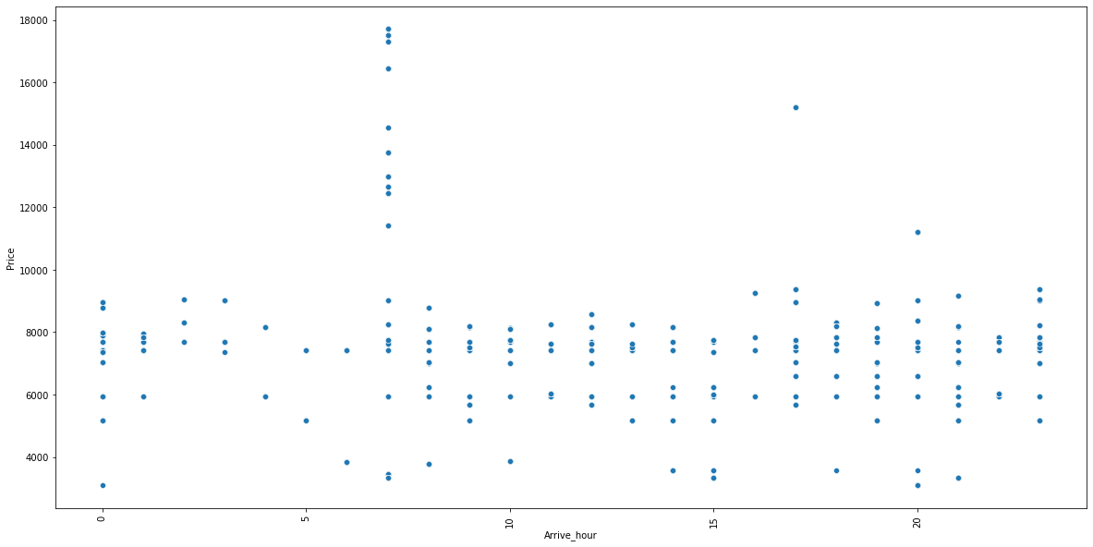
Those flights which has arrival time between 6 am to 10am has the highest cost as these timings are most
preferred for arrival as the passengers get the entire day to do their work.

Slide 24
Hardware and Software Requirements and Tools Used
We imported following packages:
import pandas as pd
import numpy as np
import matplotlib.pyplot as plt
import seaborn as sns
from sklearn.preprocessing import OrdinalEncoder
from sklearn.preprocessing import LabelEncoder
from statsmodels.stats.outliers_influence import variance_inflation_factor
from scipy.stats import zscore
from sklearn.model_selection import GridSearchCV
from sklearn.preprocessing import StandardScaler
from sklearn.preprocessing import power_transform
from sklearn.model_selection import train_test_split
from sklearn.model_selection import cross_val_score
from sklearn import metrics
from sklearn.metrics import mean_squared_error, mean_absolute_error

Slide 25
Run and Evaluate selected models

Slide 26
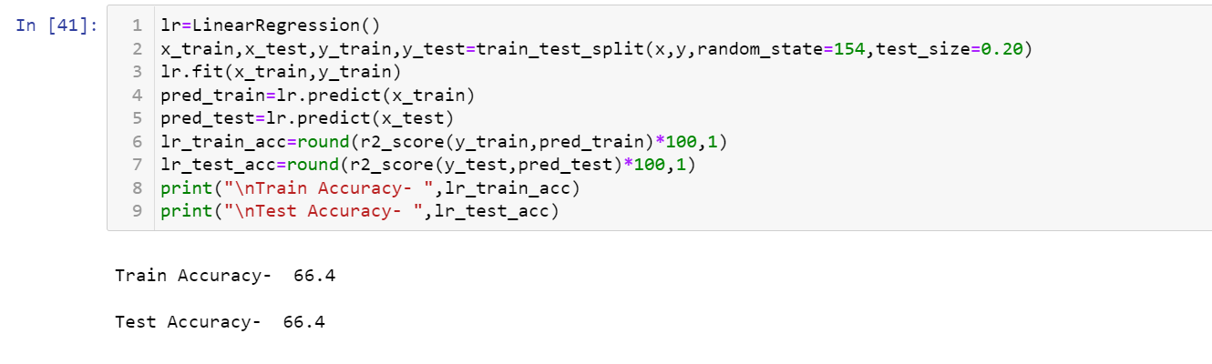
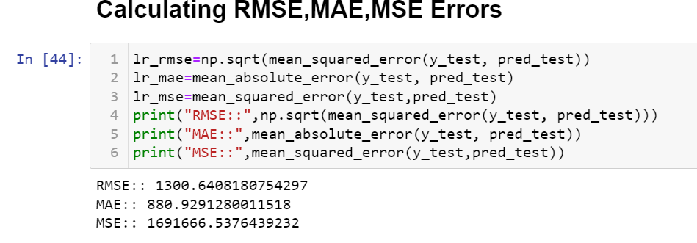
Linear Regression
We applied this algorithm and found the train accuracy to be 66.4% and test accuracy to be 66.4%.
We also tested this model on other metrics:
We calculated Root mean square error, Mean absolute error and Mean square errors and there values are shown in the snapshot below:
Looking at these errors we can say that model is
not performing really well.

Slide 27
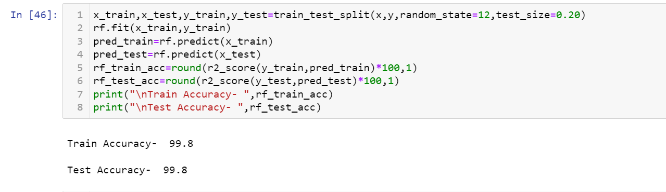
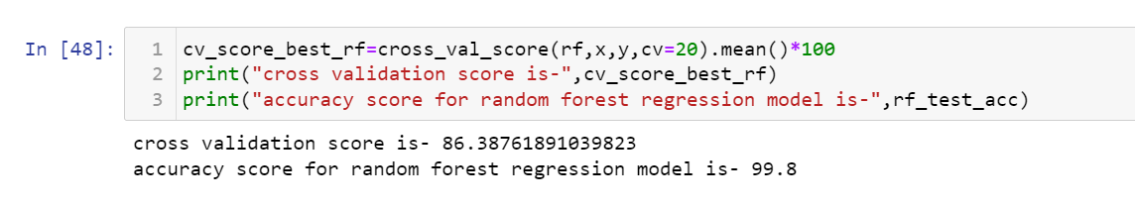
Random Forest Regressor
We applied this algorithm and found the train accuracy to be 99.8% and test accuracy to be 99.8%.
The test accuracy for random forest regression is 99.8% and its cv score is 86.3% thus making us sure that
the model is not overfitted.

Slide 28
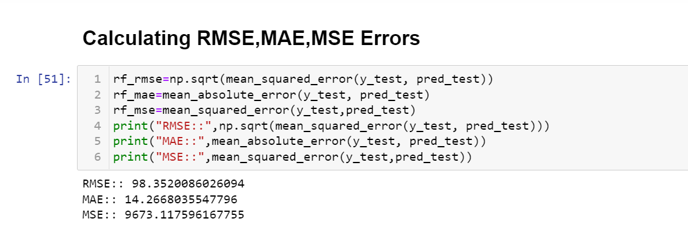
We also tested this model on other metrics:
We calculated Root mean square error, Mean absolute error and Mean square errors and there values
are shown in the snapshot below:
Looking at these errors we can say that model is performing really well.

Slide 29
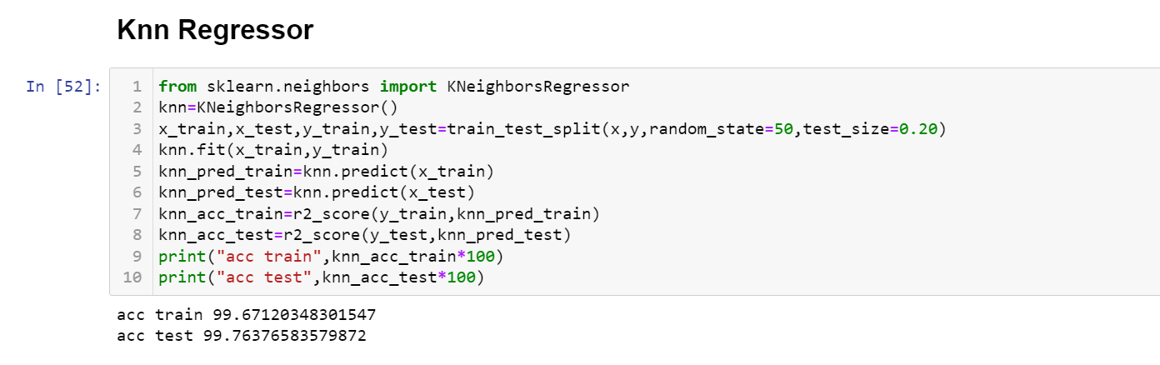
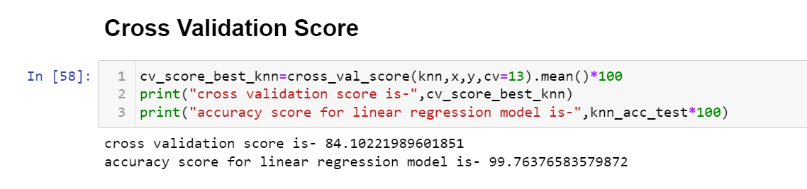
Knn Regressor
We applied this algorithm and found the train accuracy to be 99.7% and test accuracy to be 99.7%.
The test accuracy for Knn regression is 99.7% and its cv score is 84.15% thus making us sure that the
model is not overfitted.

Slide 30
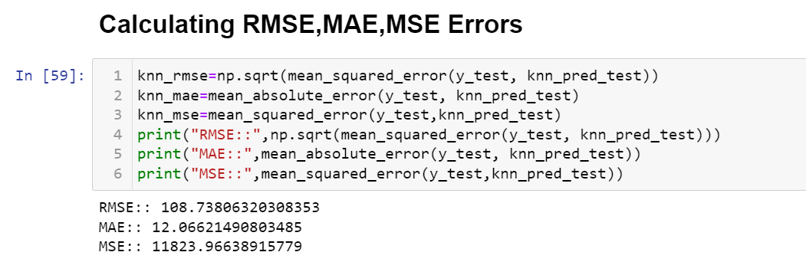
We also tested this model on other metrics:
We calculated Root mean square error, Mean absolute error and Mean square errors and there values are
shown in the snapshot below:
Looking at these errors we can say that model is performing well but not as good as previous random
forest models.

Slide 31
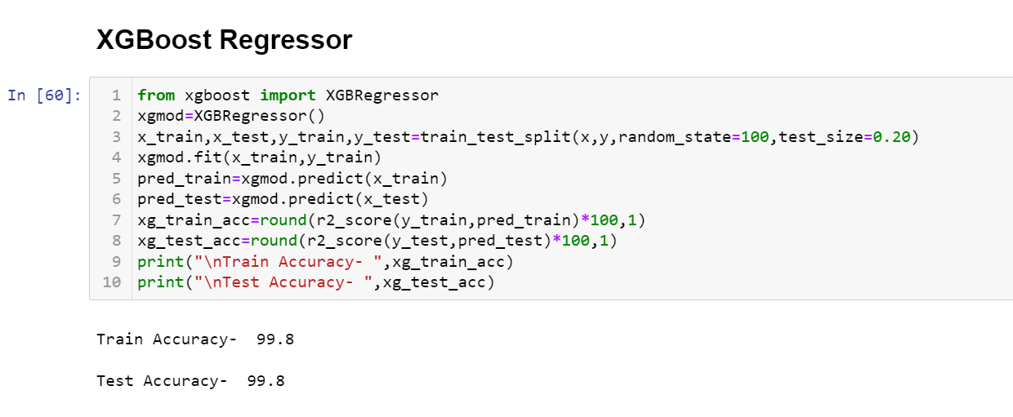
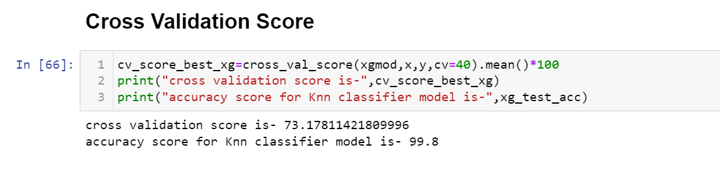
XGBoost Regressor
We applied this algorithm and found the train accuracy to be 99.8% and test accuracy to be 99.8%.
The test accuracy for XGBoost regression is 99.8% and its cv score is 73.17% thus it seems that model is overfitted
although xgboost is an ensemble technique that eliminates the problem of overfitting.

Slide 32
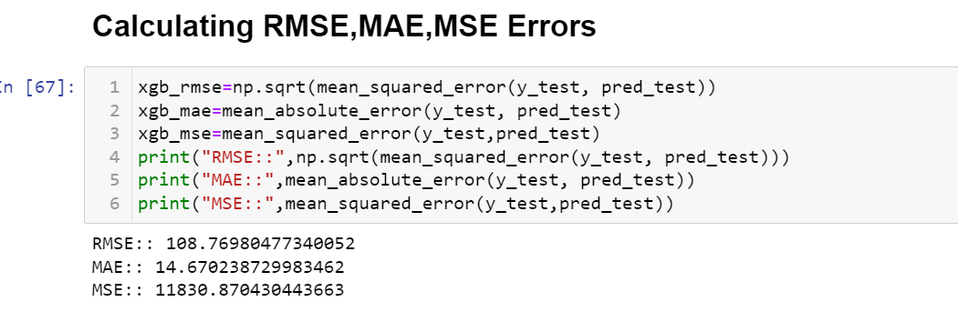
We also tested this model on other metrics:
We calculated Root mean square error, Mean absolute error and Mean square errors and there values are
shown in the snapshot below:
Looking at these errors we can say that model is performing well but not as good as random forest regressor.

Slide 33
The best performing model is random forest Regressor as its test accuracy and CV score both are almost same. The Root mean square error, mean absolute error and mean square error is least for random forest regressor so we will finalize this model.
Since the accuracy is at its best so we don’t need to perform hyper parameter tuning on it. so lets save our model.

Slide 34
CONCLUSION

Slide 35
If tickets are booked 3-4 months after current date then it would be much cheaper as compared to instant booking.
If the tickets are booked for year-end or for any festive season has to be costlier no matter what.
Those flights which has arrival time between 6 am to 10am has the highest cost as these timings are most preferred for arrival as the passengers get the entire day to do their work
Late night flights and early morning flights are cheaper as people less prefer taking flights at these odd timings
It seems that the duration is linearly related with price so more the duration more is the flight price and vice-versa.
Flight with 2 stops has higher fares as compared to flights with non-stop flights.
Air India and Indigo are the most opted flights with Air India having the highest fares.

